Slide 1
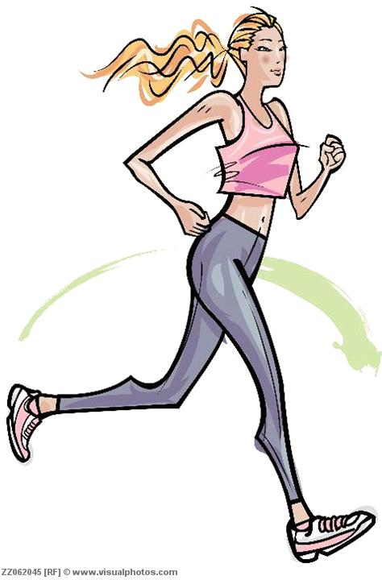
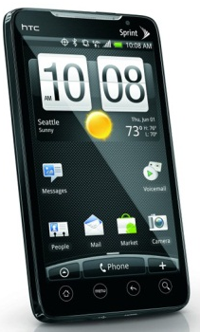
Human Activity Recognition using Smartphone
Venkateshwar Rao N
Project Presentation
Notes:
Jay

Slide 2
Outline
Introduction
Human Activity Recognition
Goals
Literature Review
Methods
Data Collection
Feature Selection
Classification Techniques
Results
Conclusions
Notes:
Jay

Slide 3
Introduction: Human Activity Recognition
Using sensors to identify human activities
such as running, walking, laying, walking upstairs,
and walking downstairs.
Motivation
Human survey (study human daily activities)
Medical care (diabetes, elderly, rehabilitation)
Sensors types
Inertial sensors (accelerometer, gyroscope)
Camera
GPS
Smartphone is small and convenient to carry around and its computational resource is powerful enough for our purpose.
Notes:
Jay

Slide 4
Goals
Design a simple, light weight, and accurate system that can learn human activity with minimum user interaction.
Compare and find a model that best fit our system in terms of accuracy and efficiency.
Notes:
Jay

Slide 5
Methods
Data Collection
Smartphone: Samsung Galaxy SII
Sensor: 3D accelerometer,50 Hz
Cellphone around waist
30 people 6 activities: walking, laying, walking upstairs, walking downstairs, sitting, standing
Attribute: For each record in the dataset it is provided:
Triaxial acceleration from the accelerometer (total acceleration) and the estimated body acceleration.
Triaxial Angular velocity from the gyroscope.
A 561-feature vector with time and frequency domain variables.
Its activity label.
An identifier of the subject who carried out the experiment.
Notes:
Jay

Slide 6

Methods
Feature Selection
Random Forest
The toughest part is to optimize the parameters such as “mtry” for random forest and setting the threshold for eliminating the subjects based on prediction accuracy.
The threshold for feature selection was done by trying various values of cut-off and selecting the best cut-off value.
Classification Techniques
Support Vector Machines
Bagging of SVM was done 27 times for prediction
Notes:
Amin

Slide 7
Results:
Feature Selection using Random Forest by choosing the “mtry” value that gives least error
Algorithm: Bagged SVM –bagged SVM 27 times
Classification Rate of Bagged SVM: 96%
Notes:
Amin

Slide 8
Works in Progress
Improving the performance for activity recognition problem
The model can further be improved by fixing known activity prediction errors of test data.
Adding more activities such as biking
Notes:
Yan

Slide 9
Conclusions
We achieved a classification rate of over 96% on 6 human activities using a smartphone.
The result is robust to common positions and orientations of cellphone.
Random Forest+SVM gives the best performance and is promising to run on mobile devices.
Performance of this model is highly sensitive to the type of problem

Slide 10
Thank you!
Questions?

